Slide 1
PR- 28
Signal Processing Primitives With Quantum Algorithm
G-RIS
(G=Gal Winer(Team Lead), R=Risav, I= Ibrahim)

Slide 2
Motivation
Developing algorithm and package that encodes digital images into Quantum Circuits and applies the Quantum Mean Filter using the Classiq platform, resulting in enhanced image quality.

Slide 3
Table of Content
DSP and Why Digital Signals
Quantum Approach For DSP (QDSP)
Application of QDSP
Project that implements Quantum Signal Processing
Project That we gonna Implement
Current Goal
Using Classiq For ?

Slide 4
DSP (Digital Signal Processing)
It's a technology that processes and manipulates digital signals, such as audio, video, or sensor data, using mathematical algorithms and computational power.
DSP is used in a wide range of applications, including audio processing, image processing, telecommunications, and control systems, to analyze, filter, and transform digital signals for various purposes.
Why Digital signal over Analog Signal?
Digital signals can convey information with less noise, distortion, and interference. Digital circuits can be reproduced easily in mass quantities at comparatively low costs. Digital signal processing is more flexible because DSP operations can be altered using digitally programmable systems.

Slide 5
Quantum Approach FOR DSP
Quantum Digital Signal Processing (QDSP) is an emerging field at the intersection of quantum computing and traditional digital signal processing.
Quantum Computing promises to solve most of the Problem in polynomial time which was able to solve in exponential time using Classical Computer.
Some of the major Quantum Properties that can be implemented in DSP are:
Quantum Superposition:
In the context of DSP, Quantum Superposition, where quantum bits (qubits) can exist in multiple states simultaneously, can be advantageous for parallel processing and performing multiple signal processing tasks at once.
2. Quantum Entanglement:
Entanglement allows for correlations between qubits, which can enable the development of novel signal processing algorithms, such as entanglement-enhanced sensing.

Slide 6
Application
Quantum DSP can be used mainly in the processing of the Astronomical Signals, Cosmic MicroWave Background and also the Quantum sensors are more sensible to the small signals thus we can process the many undetected and hidden information. Some of the field that can have great impact with QDSP
LIGO: For the signal processing
Image Processing of JWST signals and efficient modeling of astrophysical phenomena
Tesla : For faster image recognition useful for the Automation car
And many Signal Processing institution like NASA,Radio Astronomy Observatories
It is to be noted that the QDSP is still in infancy and research is going on this field

Slide 7
Project that Implements Quantum Signal Processing
Quantum Gaussian Filter Paper Abstract :- The classical image is converted into a quantum version based on the novel enhanced quantum representation (NEQR) of digital images, and then a unique quantum module is designed to realize the median calculation of neighborhood pixels for each pixel point in the image. Finally, in order to improve the filtering effect, extremum detection is employed to distinguish noises from true signals.

Slide 8
Project that our team gonna Implements
Quantum Mean Filter
What actually is mean filter?
A mean filter, also known as an averaging filter, is a common image processing technique used to reduce noise and enhance the quality of an image. It works by replacing each pixel's value with the average of the pixel values in its neighborhood. The neighborhood is typically defined by a small square or rectangular window around each pixel.
Why do we choose this topic?
We have done literature survey and came to the conclusion that our topic is novel. It has not been explored by anyone till now. And we believe that Quantum alternatives of classical DSP filters will pave new ways in the field of Quantum Signal Computing.

Slide 9
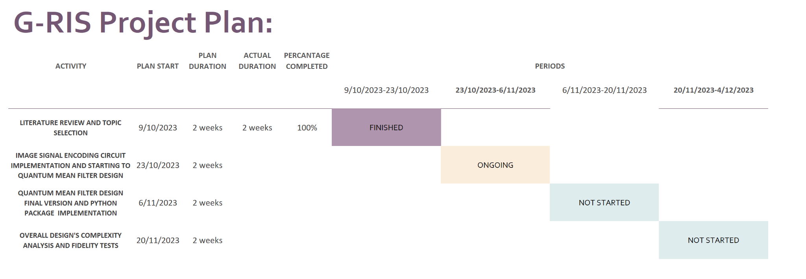
Current Goals

Slide 10
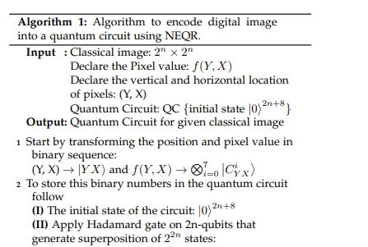
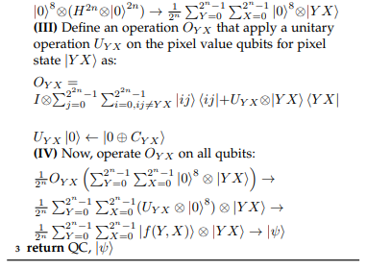
Using currently
classiq for?
Designing NEQR( Novel Enhanced Quantum Representation) for encoding Digital Signal Encoding reference Paper/Article

Slide 11
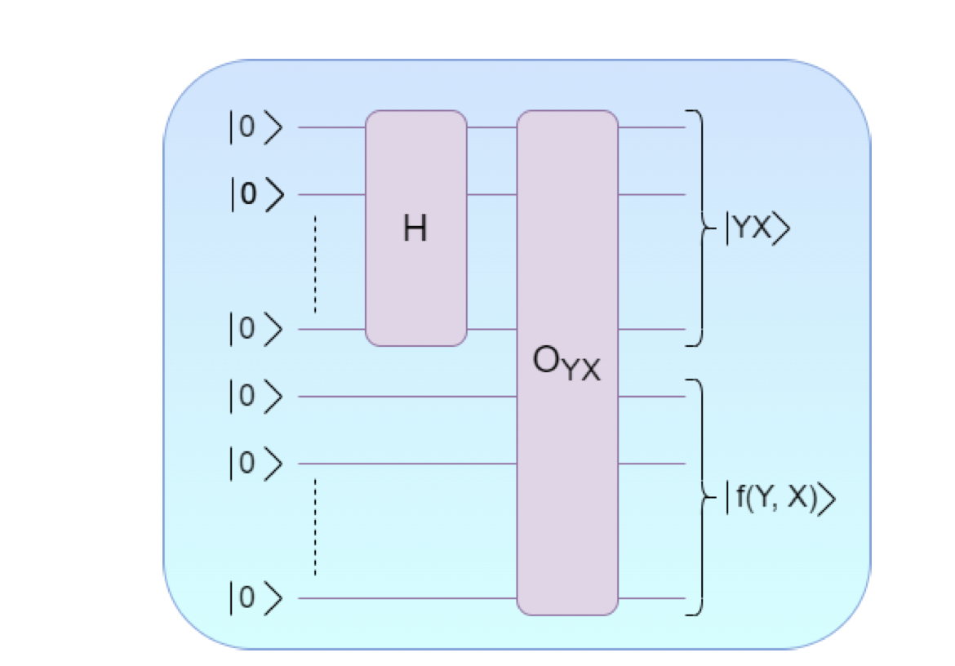

Designing NEQR( Novel Enhanced Quantum Representation) for encoding Digital Signal Encoding reference Paper/Article

